Slide 1



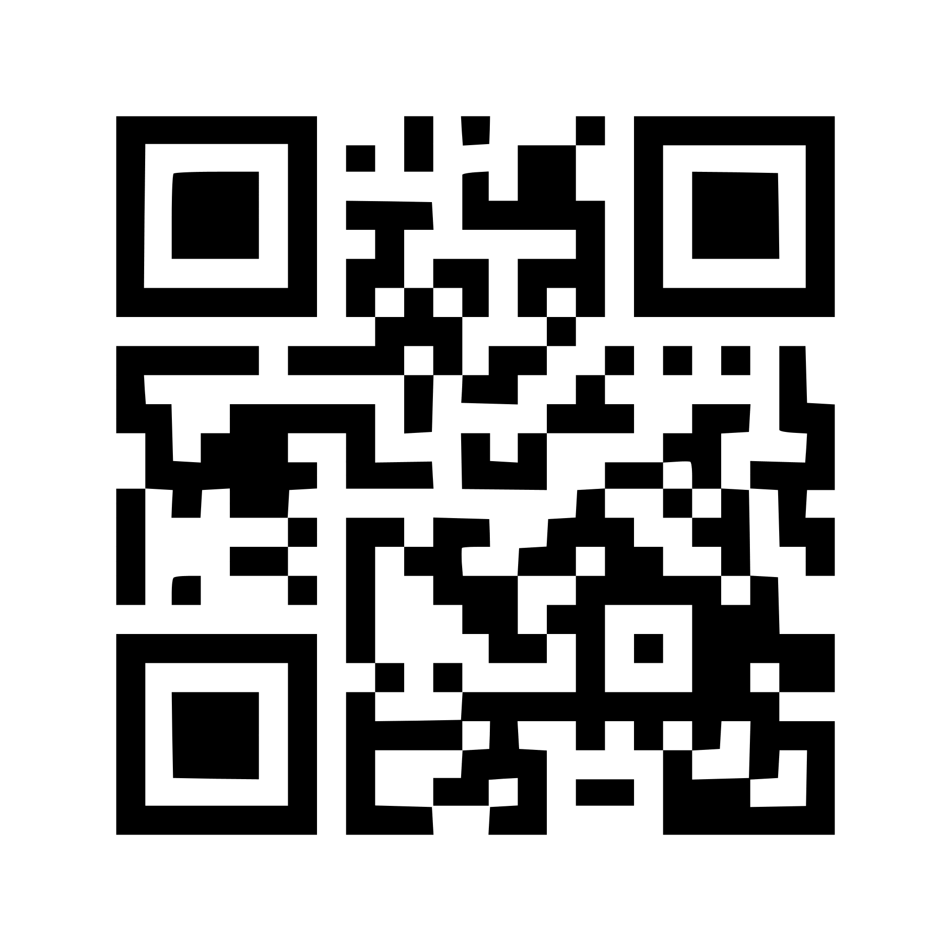
QR Based
ecommerce Application
With AI Support

Slide 2

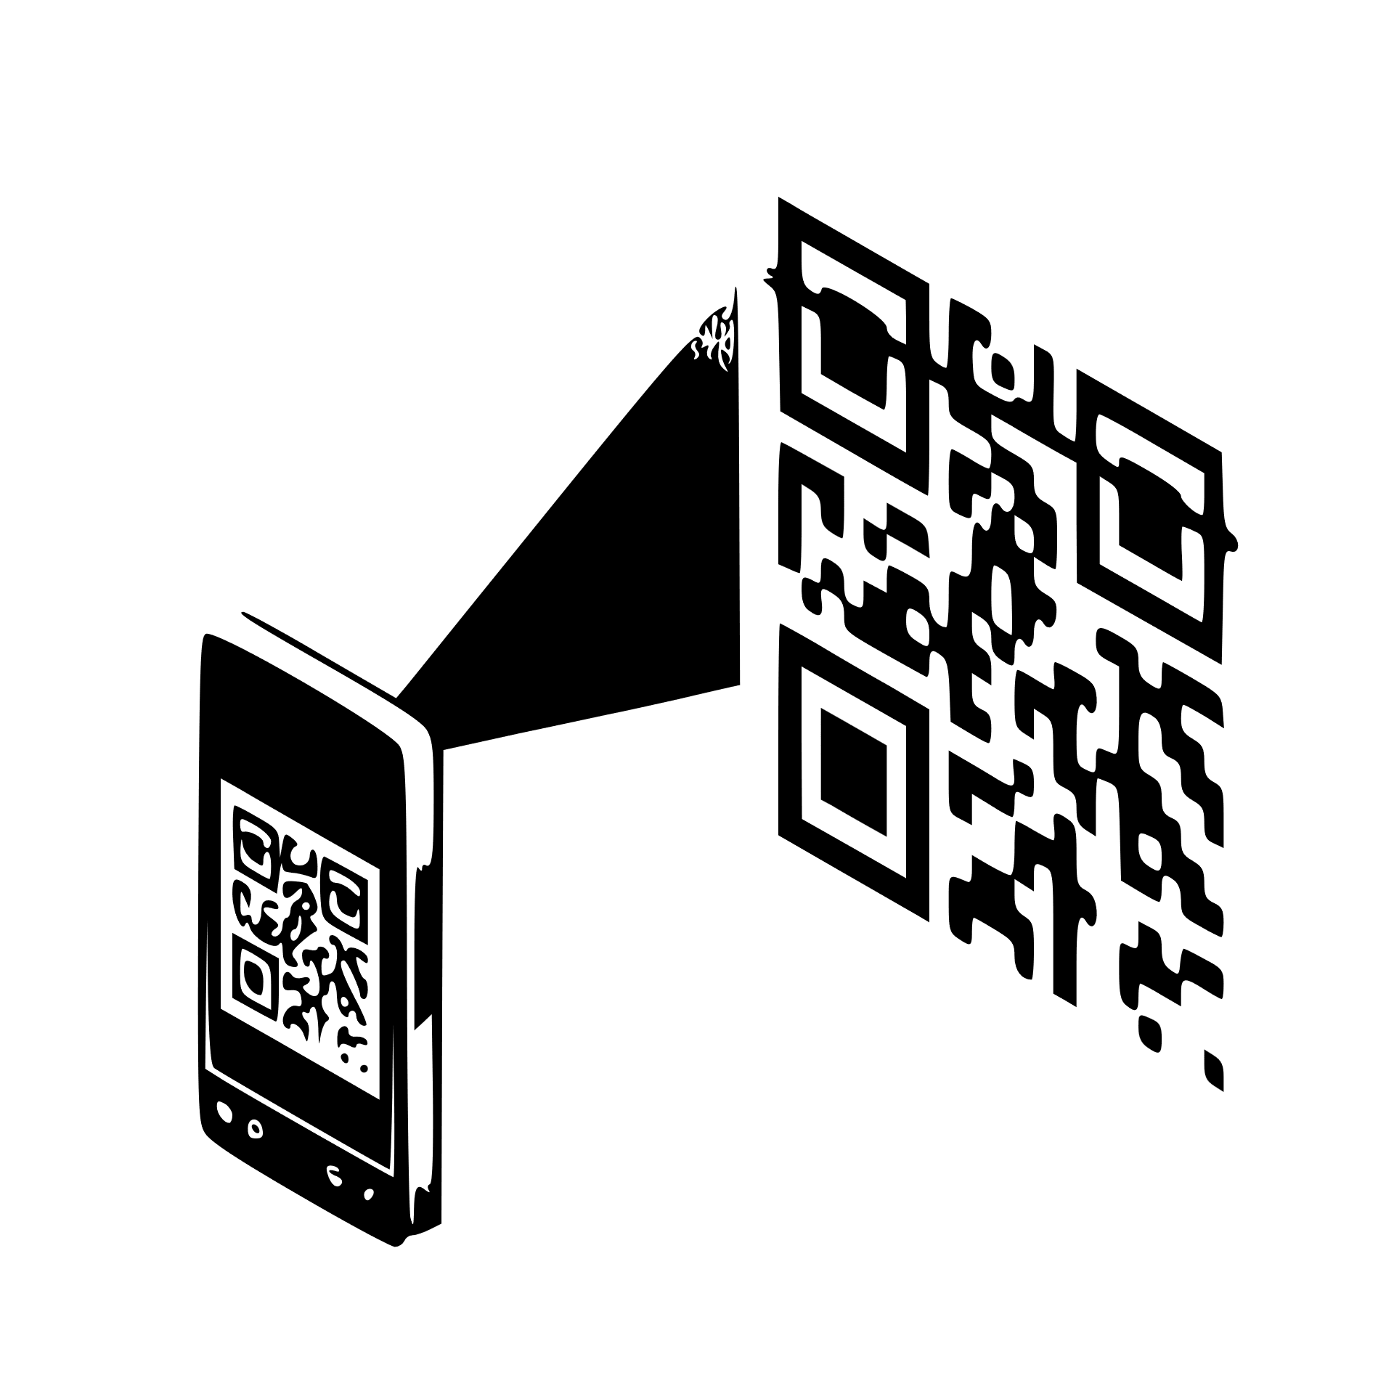


INTRODUCTION
We hereby work on an e-commerce application with the support of Artificial Intelligence.
We specially introduce QR based Authentication System.
Our application is User friendly and we mainly concentrate on customer satisfaction and comfortability.
We design separate sessions for different users. that we maintain the privacy of users and their personal information are secured.

Slide 3
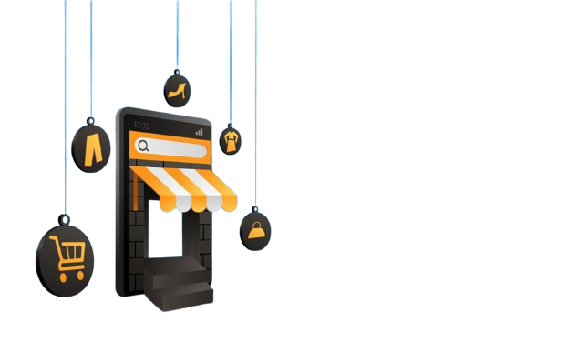
FEATURES
We exclusively use QR based login system instead of using Traditional authentication system
(Username & password system).
We Analyze data and products for consumer Comfortability.
We use Voice Recognization system to have a contactless approach.
This application is more user friendly

Slide 4


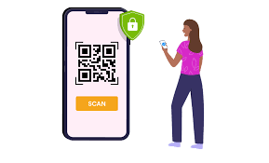

WHY NOT PASSWORDS
Password can be cracked easily.
Passwords can be shared, guessed or stolen, which means they aren't secure.
Remembering multiple password is difficult.
Problem with password can’t put in public place.

Slide 5










Technologies
Frontend
HTML
SASS
ANGULAR
BOOTSTRAP
QR & SCANNER
LIBRARIES
Backend
JAVA
SPRINGBOOT
MANGO DB IN NOSQL
RESTAPI

Slide 6

Upcoming Features
Product Analization with various platforms .
Contactless approach (neural networks).
AI based Product
recommendations and remainders.
AR based product experience.
Block chain encryption.

Slide 7



Slide 8

Product Video :)

Slide 9
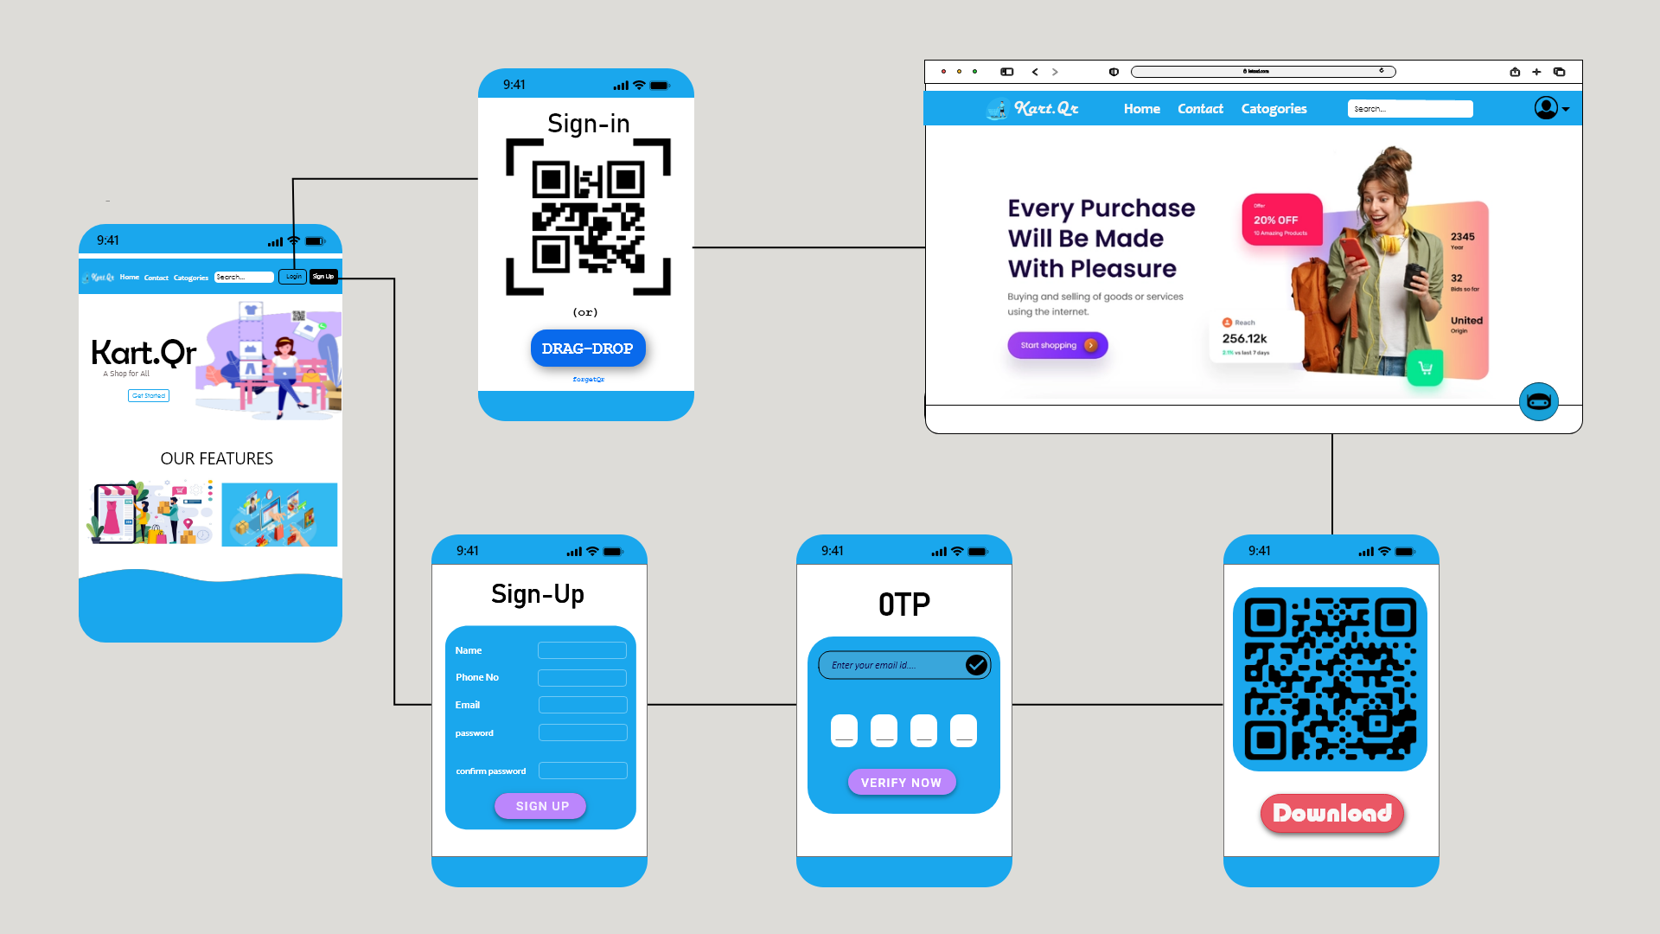
WIRE FRAME

Slide 10









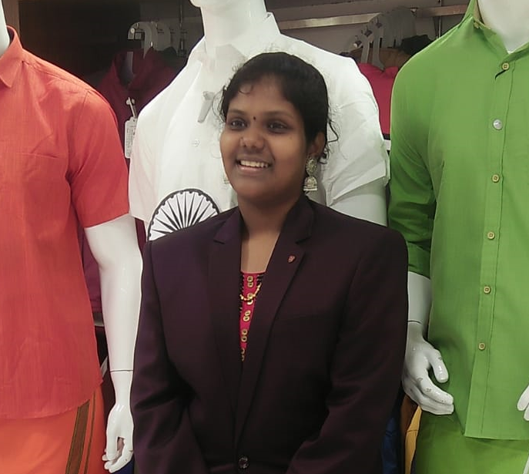


We’re
NISHANTHI K
PAVAN KUMAR P
SANTHOSH S
SRIRAM L
LILAN SHANKAR S R
PRATHIKSHA P C

Slide 11



THANKYOU !!

